Slide 1
AI LAB TEST-1
Analysis on DRDO Octopus Missile Launch & Keys Transfer
DRDO has developed a powerful missile called Octopus that can fire 8 missiles simultaneously in different directions up to 10,000 km range. To prevent theft, the launch commands are encrypted with two keys that must be transferred to the destination.

Slide 2
constraints
Gap Sizes-Keys can only jump 1 station or 4 stations at a time.
Simultaneous Transfer- Both keys must start and reach the destination together.
Linear Network-The 50 stations are connected linearly, no branching paths.

Slide 3
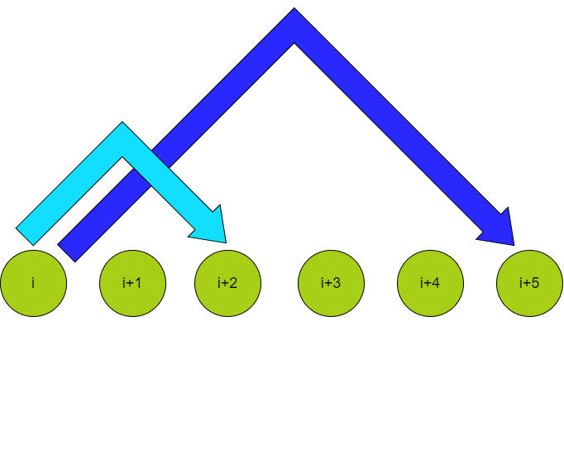
Graph transitions
Stations represents as nodes, transitions between stations as edges.
POSSIBLE TRANSITIONS:

Slide 4
Approach -BFS
To solve this problem we can use Breadth-First Search(BFS) algorithm to find the minimum number of transfers needed and the sequence required to reach destination D from station Si and Sj simultaneously.
State Representation: Represent states as (p,q) where p and q are station positions of keys Key1 and Key2.

Slide 5
Algorithm analysis
Initialization:
Start BFS from initial state (i,j).
Use a queue to manage states and a set to track visited states.
BFS Iteration:
Dequeue states and explore possible transitions.
Check validity of transitions and enqueue new states if valid and not visited.
Goal State:
Stop BFS when reaching state (50,50)(50,50).
Backtrack to determine the path taken for reaching the goal state.

Slide 6
Transition Rules
Allowed Transitions:
Move both keys to adjacent stations (((p+1,q+1)).
Move both keys to stations with a gap of 4 (((p+4,q+4)).

Slide 7
Time Complexity Analysis
Space Complexity Analysis
BEST CASE:
O(1) if initial stations are close to destination.
WORST CASE :
O(n/min(gap1,gap2)) if initial stations are far from destination.
PATH STORAGE:
O(n) for storing paths of both keys in lists.
CONSTANT SPACE:
O(1) for other variables like current stations and step count.

Slide 8
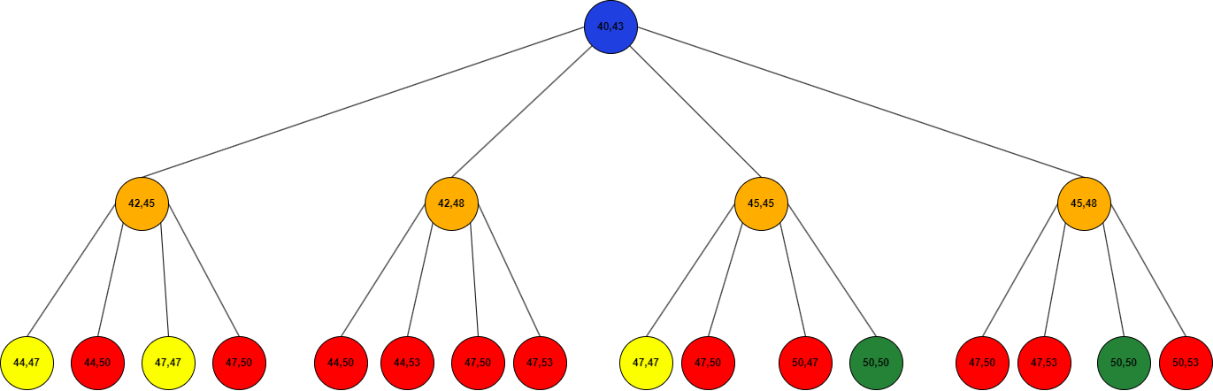
Correctness and state space
BFS guarantees finding the shortest path due to level-by-level exploration.
State representation ensures simultaneous key transfers while moving through stations.

Slide 9
result
Algorithm finds minimum transfers for valid initial station configurations.
If goal state (50,50)(50,50) is reached, output the minimum transfers and sequence.
Returns -1 when keys cannot reach destination simultaneously based on gaps.
Handles edge cases like keys starting at adjacent stations correctly.

Slide 10
CONCLUSION
BFS efficiently solves the problem of minimizing transfers for simultaneous key transfers.
Initial condition checks prevent unnecessary computation for invalid inputs.
Complexity analysis shows algorithm is efficient for practical input sizes.
State representation and transition rules are crucial for modeling the problem accurately.

